Slide 1
hotel aggregator Analysis
Mentorness Internship Program
Prepared By: Ann Wangechi

Slide 2
Problem statement
The project aims to analyze a dataset of hotel aggregator listings using Power BI. The dataset comprises various attributes related to listings, hosts, reviews, and availability. The objective is to create comprehensive visualizations and insights that shed light on trends, patterns, and factors influencing the performance of listings. Through Power BI we’ll explore key metrics such as pricing, availability, host characteristics, and review scores to derive actionable insights for improving the overall quality and competitiveness of the listings.

Slide 3
Dataset Description
id: Unique identifier for each listing.
listing url: URL of the listing on the hotel aggregator platform.
scrape_id: Identifier for the data scraping event.
last_scraped: Date of the last data scrape.
source: Source of the listing information.
name: Name of the listing.
description: Description of the listing.
neighborhood_overview: Overview of the neighborhood where the listing is located.
picture_url: URL of the listing's picture.
Host id: Unique identifier for the host.

Slide 4
Project Objectives
Geographical Insights Analysis
Pricing and Availability Analysis
Host Performance Analysis
Review Scores and Guest Satisfaction Analysis
Property Type and Room Analysis

Slide 5
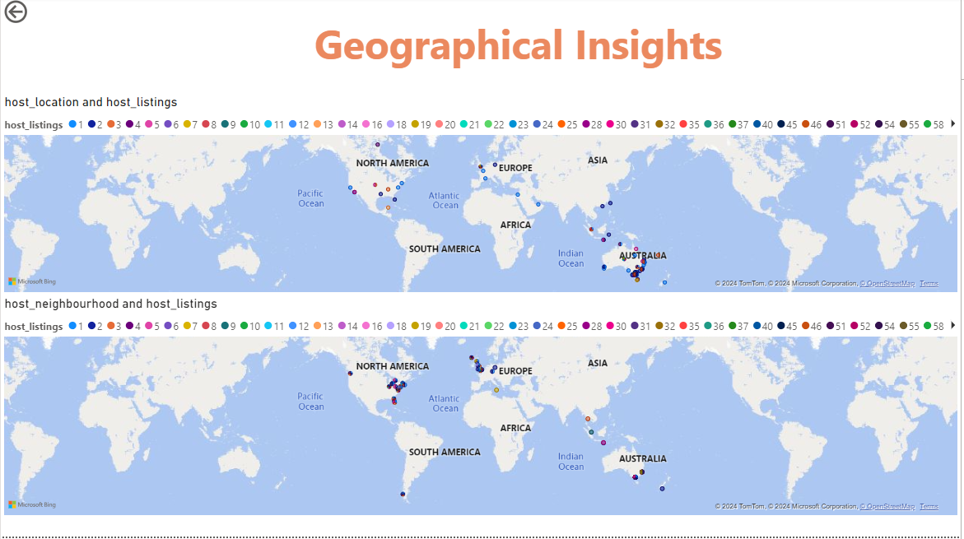
1.Geographical Insights Analysis

Slide 6
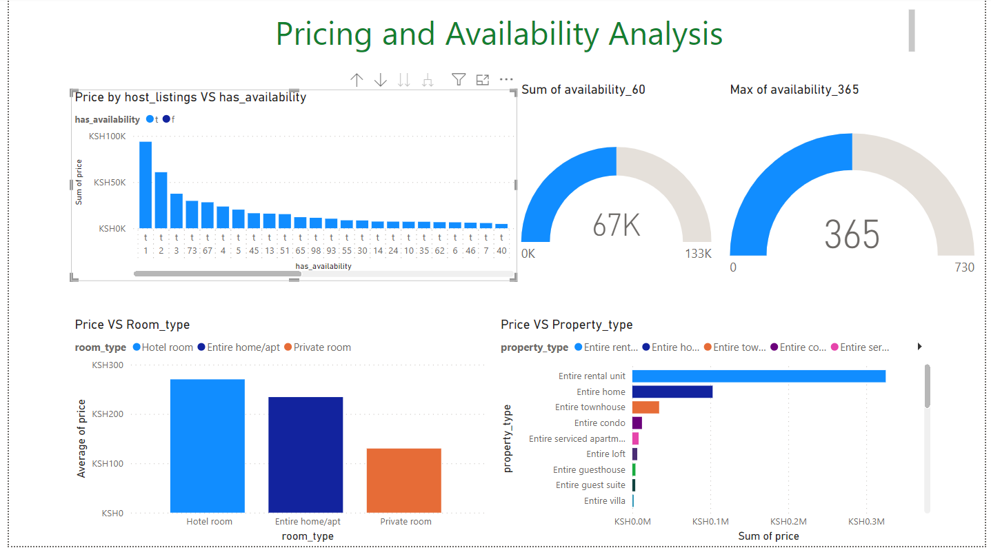
2.Pricing and Availability Analysis

Slide 7
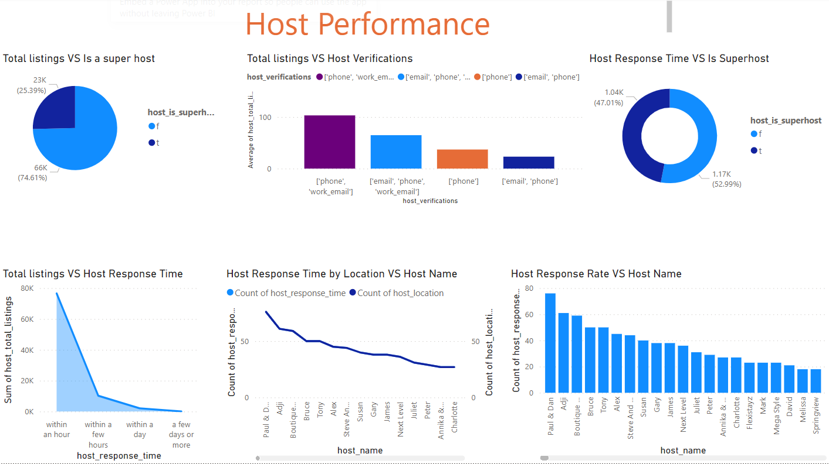
3.Host Performance Analysis

Slide 8
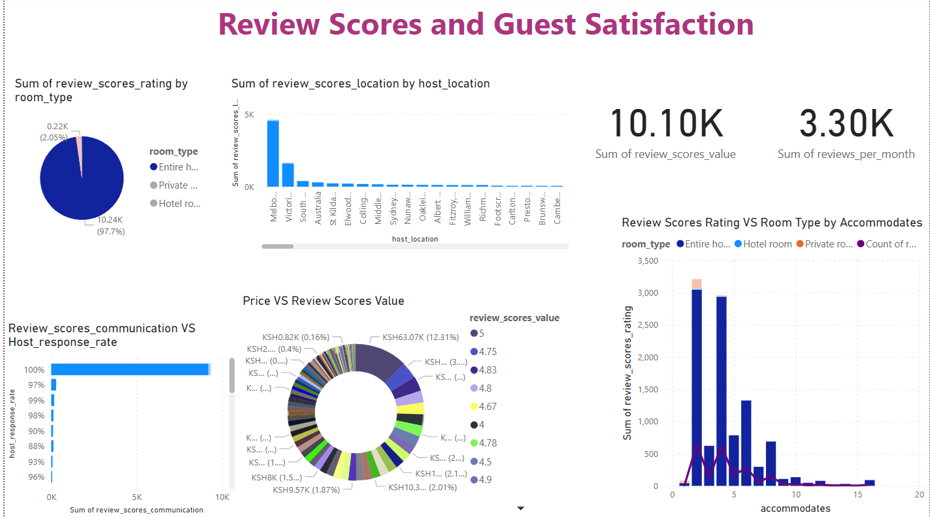
4.Review Scores and Guest Satisfaction Analysis

Slide 9
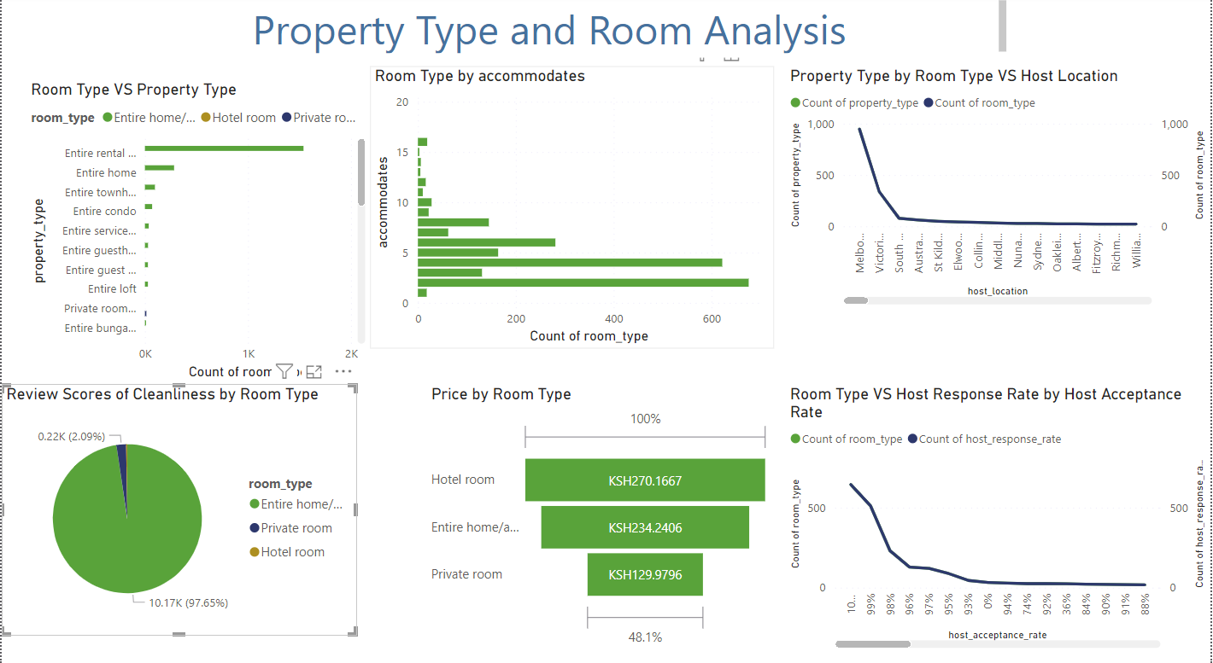
5. Property Type and Room Analysis

Slide 10
Summary and conclusions
The Power BI analysis of hotel aggregator listings offers valuable insights into geographical distribution, pricing dynamics, host performance, and guest satisfaction. Through interactive dashboards we can uncovered trends in property types, room preferences, and factors influencing listing performance. The analysis highlights opportunities for hosts to enhance competitiveness by optimizing pricing strategies, improving responsiveness, and addressing guest feedback.

Slide 11
THANK YOU!!

